Slide 1


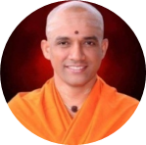



|| Jai Sri Gurudev||
Sri Adichunchanagiri Shikshana Trust®
SJB INSTITUTE OF TECHNOLOGY
(Affiliated to Visvesvaraya Technological University, Belagavi & Approved by AICTE, New Delhi.)
Accredited with NAAC ‘A’ grade
No. 67, BGS Health & Education City, Dr. Vishnuvardhan Road Kengeri, Bengaluru – 560 060
Department of Computer Science Engineering
INTERNSHIP PRESENTATION
ON
ORACLE APEX
CARRIED OUT AT
Cognizant Technology Solutions
Presented by : Harshitha Atrey [1JB21CS057]
Under The guidance of: Dr. Shantha Kumar H C

Slide 2
OVERVIEW OF INTERNSHIP WORK
DURATION: MARCH 2025 to JUNE 2025
COMPANY: COGNIZANT TECHNOLOGY SOLUTIONS, CHENNAI
The Internship has 3 phases:
DELTA PHASE: Which majorly comprised of PL/SQL, HTML, CSS, XML, REST web services, UNIX and Python
INTERIM PHASE: It majorly comprised of OCI, OIC and OCIDI
FINAL PHASE: It focuses majorly on APEX which is the major domain we are going to work on.
I am currently in the final phase of internship

Slide 3

COGNIZANT
Cognizant Technology Solutions is an American Multinational Information Technology consulting and outsourcing company.
Headquartered in New Jersey, US
It was founded in Chennai
Its core offerings are Cloud Computing, AI and Analytics, Enterprise Application Services, Consulting and IT Infrastructure.
It has about 3,36,800 employees globally and 75% of its workforce is based in India

Slide 4
ENTERPRISE PLATFORM SERVICES(EPS)
It focuses on helping clients transform their core business operations using powerful enterprise platforms.
Service Lines of EPS: HCM, ERP, Digital Process Orchestration, Digital Supply Chain Transformation, Platform Integration
Subdomains of EPS are: SAP services, Oracle APEX, Salesforce Services, Workday Services
Focus: Build low-code web applications, role based access, dynamic forms, interactive reports

Slide 5
TASKS PERFORMED
DELTA PHASE
It majorly covered basics of PL/SQL, HTML, CSS, JS, XML, REST web services, UNIX, Python
They were the Pre-requisites for our training we learnt about how to write basic PL/SQL queries using triggers, procedures, functions and cursors.
XML formats, how to use them and simple python codes and UNIX commands.
We also learnt how to work with REST APIs

Slide 6
INTERIM PHASE
It comprised of mainly OIC, OCI and OCIDI.
OIC stands for Oracle Integration Cloud which is the PaaS service used to communicate and exchange data between cloud and on-premise systems.
OCI stands for Oracle Cloud Infrastructure is the IaaS service used to build, deploy and manage applications in the cloud.
OCIDI stands for Oracle Cloud Infrastructure-Data Integration the cloud based service which is ETL/ELT service majorly to extract, transform and load the data.

Slide 7

OIC
We majorly learned to design Integrations, connections, adapters, agents, events, libraries, packages and lookups.
We also learned about the various actions in OIC which include the assign, map, wait, logger, notifications and call back services
We learned about the inbound and outbound connections to OIC which majorly focused on bulk loading.
We learned about the major SaaS services present in cloud which included ERP, SCM and HCM.

Slide 8
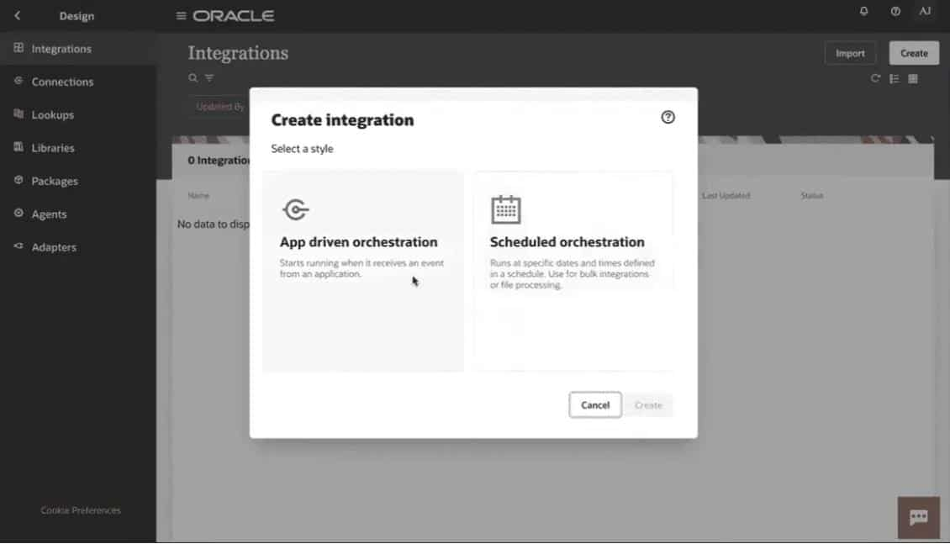
OIC Console

Slide 9
OCI
It majorly included the cloud computing service and deployment models
In OCI first when we login to the console the tenancy and created after which a compartment should be created, then VCN is created for internet connectivity
Then a Compute instance is launched and accessed using SSH keys
Then an object storage is created for storage of objects and IAM policy is created to provide access to user groups.

Slide 10
OCIDI
The major features of OCIDI are- No code data flow, data immersive experience, Automated schema drift protection, Hybrid data execution, Optimized for Oracle and Pay as you go model
Its major use cases are- Data Integration for big data, data lakes, fast ingestion of data and ingestion of data from multiple sources.
It majorly includes tasks, pipelines and dataflows
There are different types of tasks which can be created based on the requirement like data loader task, integration task, pipeline task, REST task, SQL task and OCI dataflow task.

Slide 11
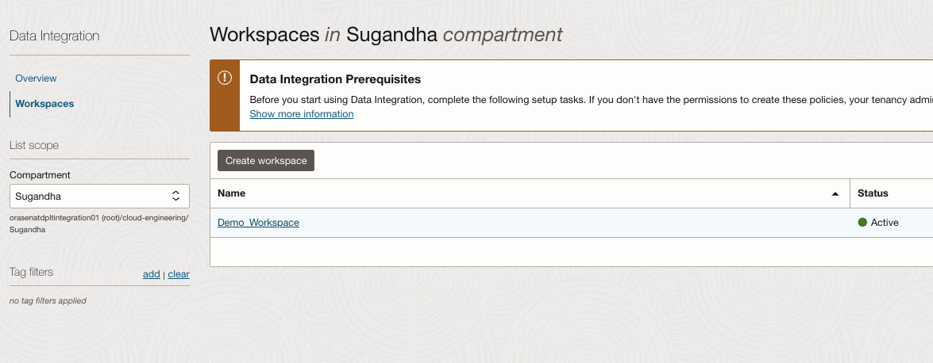
OCIDI

Slide 12
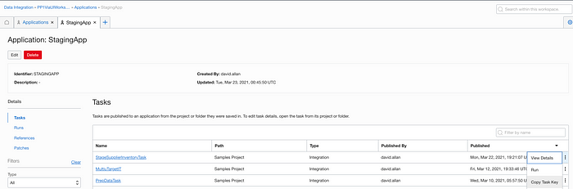
OCIDI

Slide 13

APEX(FINAL PHASE)
We are currently in the final phase and are learning about APEX.
APEX stands for Application Express which is a low code development platform provided by Oracle to build secure and scalable web applications.
Easily and fully integrated with Oracle Database
It is completely a web based development.
Some of the applications which we built using APEX are as follows

Slide 14
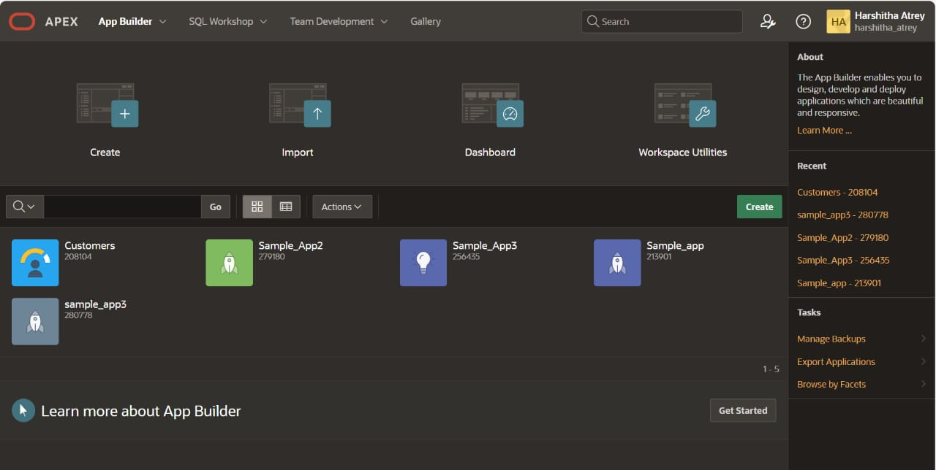
APEX

Slide 15
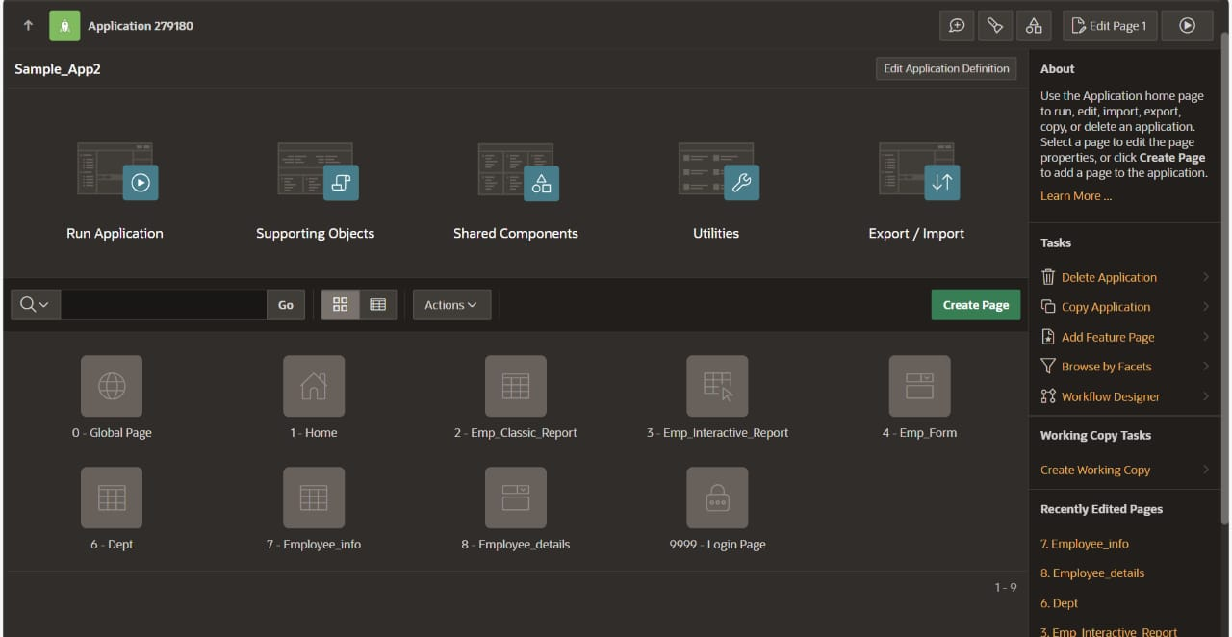
APEX

Slide 16
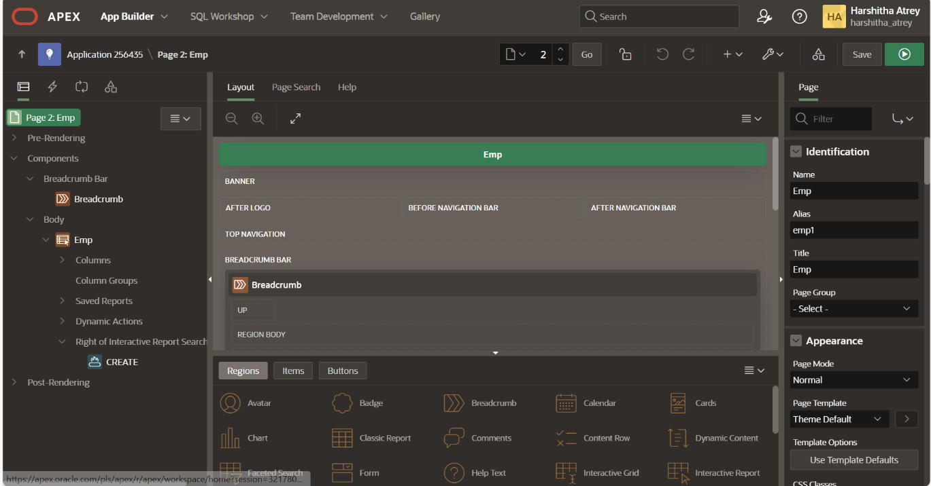
APEX

Slide 17
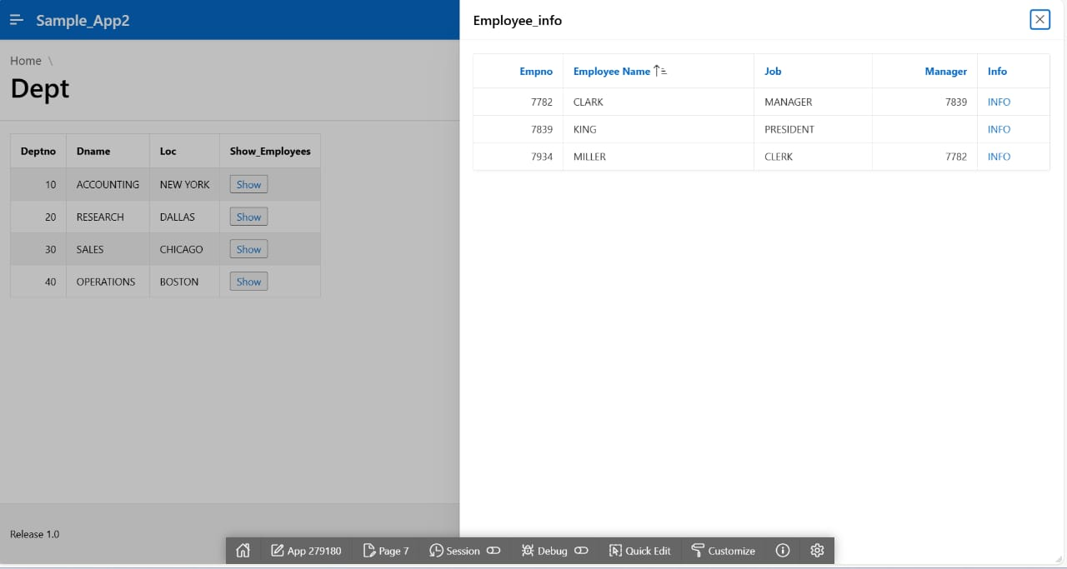
APEX

Slide 18
SOFT SKILLS TRAINING
Apart from technical skills we also had soft skills training in which we were taught about the Email etiquettes, Group Discussion, MOM writing, call etiquettes and interview training
We also improved teamwork through daily activities and reviews
We majorly learned about professional communication

Slide 19
OTHER ACTIVITIES
We had leadership connect programs and some of career building sessions where in we were introduced to our domain and were told about the various opportunities of growth in our domain.
With this we were introduced to our working domain and also got a lot about Cognizant work ethics

Slide 20
REFLECTION NOTES
Gaining hands-on experience with Oracle APEX, OIC, OCI
Understood cloud deployments, workflows and automation.
Improved our teamwork and confidence through soft skill sessions.
Built a strong foundation for career in cloud integration and low code platforms.
Have learnt about the enterprise applications and different Oracle technologies

Slide 21
CONCLUSION
The internship at Cognizant Technology Solutions provided a platform to apply academic knowledge in real world applications
Gained practical experience in real world projects and activities
Developed professional skills and got exposure to various cloud solutions and various low code applications
Laid a solid foundation for my future career in cloud computing and integration

Slide 22
THANK YOU

